Slide 1


Impact of Social Sciences, Humanities and Arts Conference
The Roundtable Session on:
Training and Skills
13 October, 2021

Slide 2


Impact of Social Sciences, Humanities and Arts
13-15 October, 2021
Sandra Lapointe: Professor of Philosophy and Director of The/La Collaborative, McMaster University, Canada
Anika Duut van Goor Director of the international AESIS Network, the Netherlands
Overview of the Coordinators
#SSHA21

Slide 3
Impact of Social Sciences, Humanities and Arts
13-15 October, 2021
Sandra Lapointe
Professor of Philosophy and Director of The/La Collaborative, McMaster University, Canada
Anika Duut van Goor
Director of the international AESIS Network, the Netherlands
#SSHA21

Slide 4


SKILLS FOR PARTNERSHIPS, COLLABORATION AND INTERDISCIPLINARY RESEARCH IN SSHA
Context
End-user integrated research and co-creation are effective modes of knowledge mobilisation and dissemination. There is strong evidence that social sciences, humanities and arts (SSHA) researchers involved in collaboration, interdisciplinary projects and cross-sectoral partnerships have increased impact. However, collaborative settings present specific challenges, and SSHA postgraduate training should be designed to equip researchers to address these challenges.
Evidence
What are the “foundational skills” associated with leadership and collaborations? Foundational Skills and What the SSH Need to Know provides an answer based on a qualitative analysis of skills-talk in the grey literature:

Slide 5
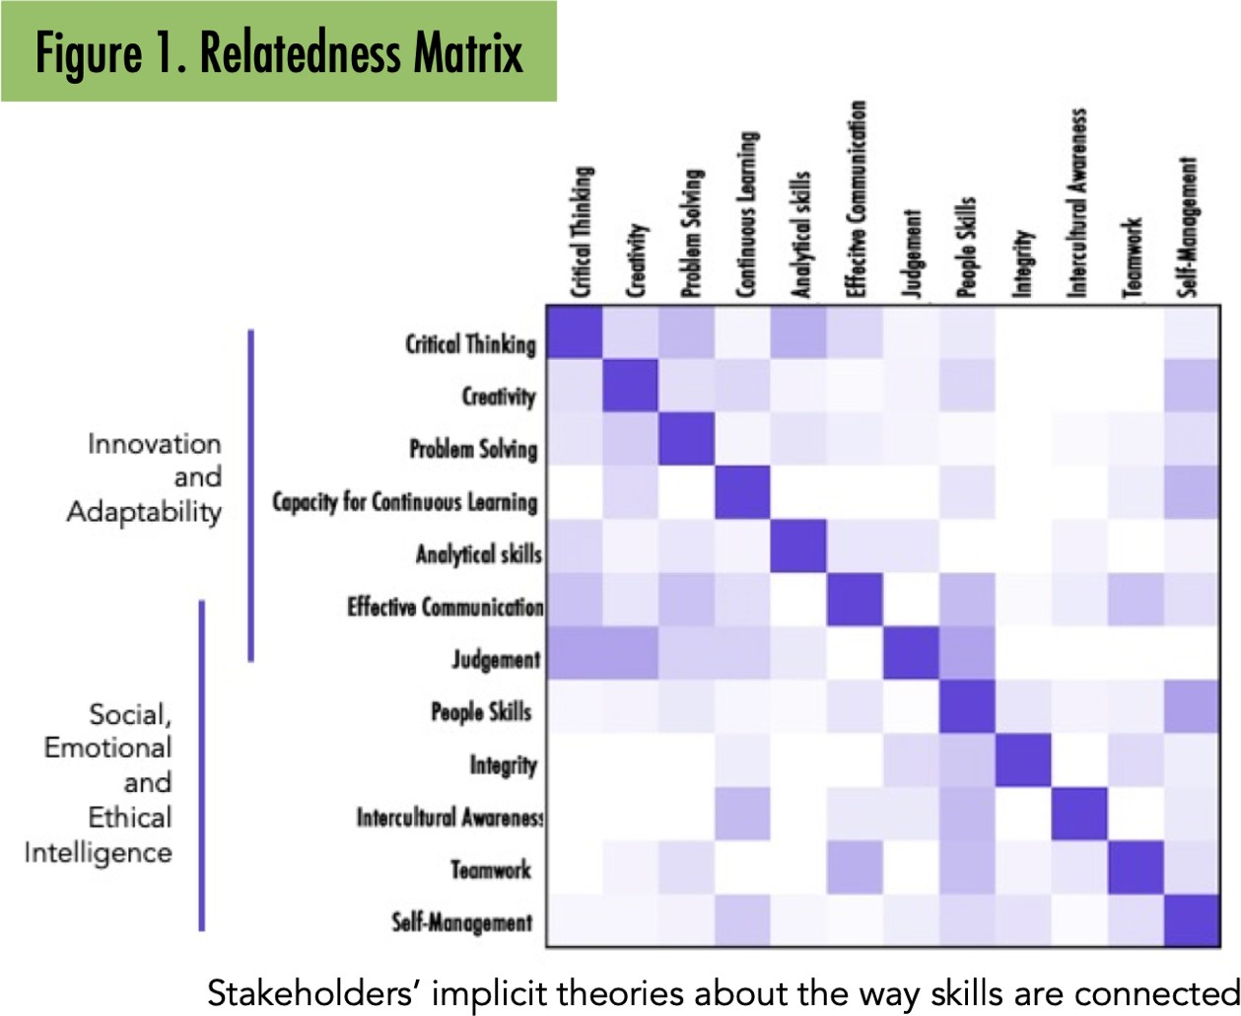

Slide 6
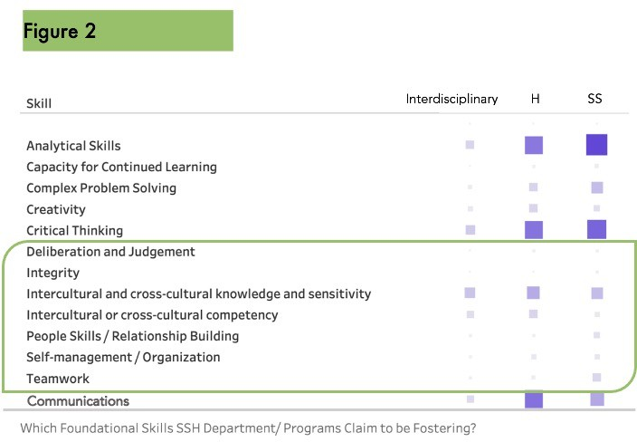
The same research also shows that, at least in Canadian universities, SSHA departments and programs tend to capitalise on the perceived values of skills associated to innovation when promoting their programs. The same however does not hold when it comes to the skills associated with leadership and collaboration, that is, with so-called social, emotional and ethical intelligence.

Slide 7
Discussion
Should the “skills for collaboration and leadership” associated with social, emotional and ethical intelligence be fostered as part of the “professional development” of SSH postgraduate students?
  Are there principled reason to refuse to see this as part of universities’ mission?
Are skills for collaboration and leadership equally valuable in academic research, as they are in other type of SSHA PhD employment outcome (e.g. non-entry-level job in social, public sectors and industry)
Who is responsible for the relevant training?
  Should we expect supervisors to equip their supervisees with the skills they need for collaboration and leadership? (De we need to upskill supervisors too, and how realistic is that?)
  Should we provide graduate students with self-directed skills-building resources, e.g. workshops, self-paced units (Who in universities is in charge of development and delivery: individual department, faculties, schools of graduate studies?)
  What is the potential of work-integrated learning, service learning and experiential learning more generally in building collaboration and leadership skills? (Would such opportunities benefit from prior skills-building and training?)
What are the drivers (incentives) and barriers (e.g. academic cultures, institutional structures) to building skills for partnership and collaboration in postgraduate SSHA students?
Moderators:
Anika Duut van Goor, CEO of AESIS a.duutvangoor@aesisnet.com
Sandra Lapointe, Professor of Philosophy and Director of The/La Collaborative at McMaster University
lapointe@mcmaster.ca

Slide 8
Impact of Social Sciences, Humanities and Arts
13-15 October, 2021
Thank you!
#SSHA21

